Slide 1
INTRODUCTION TO OBJECT ORIENTED PROGRAMMING IN C#-Part1

Slide 2
Objective
What is Class and Object?
C# and Object Orientation
Access Specifiers and Modifiers
What is Encapsulation?
What is Abstraction?
readonly and constant members
Using methods in C#
Using Instance Data
Namespaces

Slide 3
What Is a Class?
CAR?
For the philosopher…
An artefact of human classification!
Classify based on common behaviour or attributes
Agree on descriptions and names of useful classes
Create vocabulary; we communicate; we think!
For the object-oriented programmer…
A named syntactic construct that describes common behaviour and attributes
A data structure that includes both data and functions

Slide 4
Defining a Class
A class acts as the template from which an instance of an object is created. The class defines the properties of the object and the methods used to control the object's behavior.
A class specifies the structure of data as well as the methods which manipulate that data. Such data and methods are contained in each instance of the class.
A class is a model or template that can be instantiated to create objects with a common definition, and therefore common properties, operations and behavior.
A class provides a template for defining the behavior of a particular type of object. Objects are referred to as “instances” of a class.

Slide 5
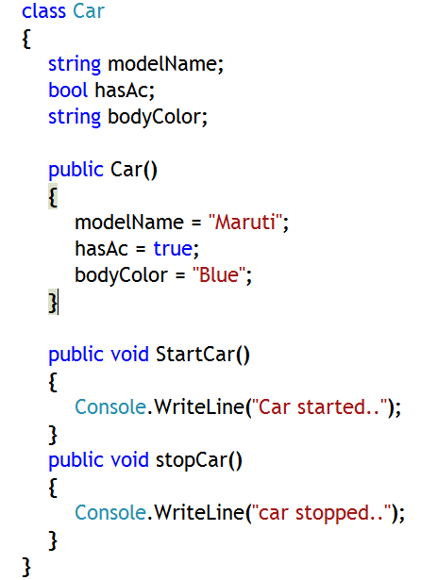
Defining a C# Class and its Members
A C# class denotes a category of objects, and acts as a blueprint for creating such objects
It defines its members referred to as fields and methods
The fields (also known as variables or attributes) refer to the characteristics of the class
The methods (also known as operations) refer to behaviors that the class exhibits
Notes:
Notes:
A class is essentially a description of how to construct an object that contains fields and methods.. It provides a sort of template for an object.
In C# the data items are called fields and the functions are called methods.
Class declarations define new reference types. A class can inherit from another class, and can implement interfaces.
Generic class declarations have one or more type parameters.

Slide 6
What is an Object?
Everything is an Object
Anything that you can describe can be represented as an object, and that representation can be created, manipulated and destroyed to represent how you use the real object that it models.
Notes:
Notes:
So what is an object?
An object embodies its own unique behavior, and each one models some object in the real world (and is therefore something that exists in time and space). A car or a book are examples of such objects. You can describe a car, repair it, drive it, and/or even sell it. You can buy a book, read a book, and/or even provide a review of the book.
But in the real world, tangible items are not the only kind of objects that are of interest to us during software development. A work assignment, for example, is not something you can touch but you can describe it, discuss it, assign it and/or complete it. Book borrowing is also not tangible but you can describe it, monitor it and/or report it.
Basically, anything that you can describe can be represented as an object, and that representation can be created, manipulated and destroyed to represent how you use the real object that it models.

Slide 7
Defining an Object
1. An object is an instance of a class
2. An object is a self-contained entity
with attributes and behaviors
Attributes
Behaviors
Information an object must know:
Identity – uniqueness
Attributes – structure
State – current condition(Objects store information)
Behavior an object must do:
Methods – what it can do
Events – what it responds to
3. In object-oriented programming, objects communicate and interact with each other using messages.
Notes:
Notes:
Each object defines three basic types of information that it must know:
1. An object has to describe the features that will allow its users to distinguish it from other objects. It needs to have an identity. Even if two objects share the same features, each object has a unique identity.
2. An object must be able to describe itself. This type of information is stored in an object’s attributes and which form the object’s structure.
3. An object must be able to describe its current condition, called its state. Object state is sometimes represented by the values of each of its attributes.
For example, a car can be brand new or worn out. Other times, the state is represented by the presence or absence of key relationships with other objects. For example, a book can be reserved or ordered. A reserved book has a relationship with the person who reserved it. An ordered book has a relationship with an order.

Slide 8
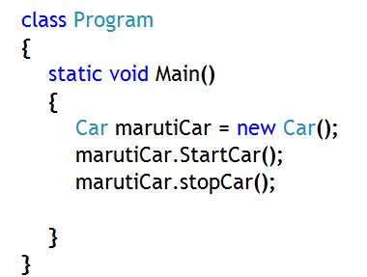

How to Create an Instance of a Class in C#?
Declaring a class variable does not create an object
Use the new operator to create an object
In memory, heap will contain the object and stack will have the reference of the object
marutiCar
Car class object
Stack
Heap
Notes:
Stack: Section of process memory space where memory spaces for local variables (local to the method, such as Main method) are allocated
Heap: Section of process memory space where memory spaces for objects are allocated
Object of Car class will be created and will be placed in the heap. The reference of the object will be stored in a variable of that class and the memory space of that variable will be allocated in the stack.

Slide 9
Access Specifiers for a Class
Class has two access specifiers
Access Specifier | Description
internal | A class declared with this access specifier is accessible from anywhere within the containing program, but not accessible from outside that program
public | A class declared with this access specifier is accessible from anywhere within the containing program as well as accessible from outside that program

Slide 10
Access Specifiers for Class Members
Access Specifier | Description
private | Access limited to the containing type. By default access is private
protected | Access is limited to the containing class or types derived from the containing class in the containing or any other program
internal | Access limited to the same or derived or any class, but in the containing program
protected internal | Available in the same or in the derived or any class in the containing program (like internal) and only in the derived classes in another program (like protected)
public | Accessible from anywhere, in the containing or derived or any other in the containing program or any other program

Slide 11
Class and Class Member Access Modifiers
Access Modifier | Description | Applied On
abstract | If used with any member of the class, then it means that the member is without an implementation in the base class and will be provided with an implementation in the derived class | Class and class members
virtual | Member of the class declared with this keyword may or may not be given a new implementation in the derived class | Only class members
override | This keyword is used to mention that a new implementation is being provided to the virtual or an abstract member inherited from base class | Only class members
sealed | If used with a class then the class can’t be derived and if used with a member of the class the member can’t be inherited | Class and class members

Slide 12
Class and Class Member Access Modifiers
Modifier | Description | Applied On
static | If used with a class, then the class contains all static members and can’t contain any non-static members and also an instance of the class can’t be created. If declared with a member then the member can’t be accessed using instance of the class, rather can be accessed using the class name. static members are ‘shared’ amongst different instances of the class | Class and class members
readonly | Assignments to the fields can only occur in the declaration or in the same class constructor | Only on fields of a class
Const | Assignments to the fields can only occur in the declaration | Only on fields of a class

Slide 13
Class and Class Member Access Specifiers
Modifier | Description | Applied On
volatile | Field can be modified in the program by something like the operating system, the hardware, or a concurrently executing thread | Only on fields of a class
extern | Indicates that the method is implemented externally | Class members
new | Allows you to declare a member with the same name or signature as an inherited member. | Class members

Slide 14
What is Abstraction?
Abstraction is a process of defining the essential concepts while ignoring the non-essential details.
It is the process of picking out (abstracting) common features of objects and procedures.
Abstraction is selective ignorance
Decide what is important and what is not
Focus and depend on what is important
Ignore and do not depend on what is unimportant
Use encapsulation to enforce an abstraction
The purpose of abstraction is not to be vague, but to create a new semantic level in which one can be absolutely precise.
- Edsger Dijkstra

Slide 15
Different Types of Abstraction
Data Abstraction
Programming languages define constructs to simplify the way information is presented to the programmer
Fields are declared with proper access specifiers, so that they are hidden from users. So, users can’t access them directly
Functional Abstraction
Programming languages have constructs that ‘gift wrap’ very complex and low level instructions into instructions that are much more readable. The method implementation details are hidden from user
Data is hidden from user, since it is private
Implementation is inside the class
User just calls the methods

Slide 16
What is Encapsulation?
1. Combining Data and Methods
Combine the data and methods in a single capsule
The capsule boundary forms an inside and an outside
Withdraw( )
Withdraw( )
balance
balance
Deposit( )
Deposit( )
Bank account related data and operations
BankAccount class
Notes:
Consider a bank account, where account maintains a balance and also supports behavior such as, withdrawal and deposit of money.
So, if you want to represent bank account through OOP, then create a class BankAccount, with a field ‘balance’ and two methods, ‘Withdraw and ‘Deposit’

Slide 17
What is Encapsulation?
2. Controlling Access Visibility
Methods are public, accessible from the outside
Data is private, accessible only from the inside
Withdraw( )
Withdraw( )
balance
û
balance
Deposit( )
Deposit( )
BankAccount class with just data and operations
BankAccount class with private data and public operations
Notes:
If you declare balance as private field then you are not allowing balance to be used directly from outside the class, thus essentially blocking the view of the variable.
But, the variable can be used by both the methods in the classs, which are public, hence are accessible outside the class.

Slide 18
Why Encapsulate?
Allows control
Use of the object is solely through the public methods
Allows change
Use of the object is unaffected if the private data type changes
Withdraw( )
Deposit( )
û
balance 12.56
Withdraw( )
Deposit( )
dollars 12
cents 56

Slide 19
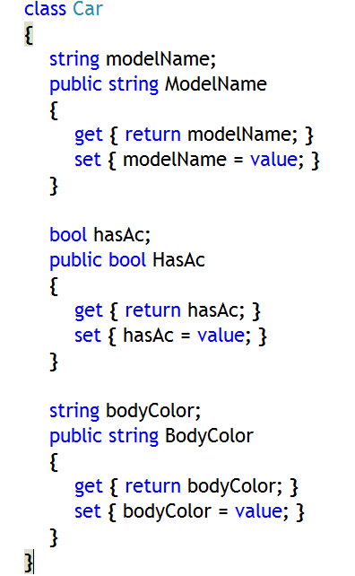
Properties – A Way of Encapsulation
Another mechanism to encapsulate fields
Properties provide:
A useful way to encapsulate information inside a class
Concise syntax
Flexibility
Properties provide field-like access
Use get accessor statements to provide read access
Use set accessor statements to provide write access
Notes:
No memory space allocation for a property.
Memory space is allocated for the local variable ‘value’ of the ‘set’ accessor
You can think of ‘set’ accessor of ModelName property like the following method:
public void set_ModelName(string value) { modelName = value; }
You can think of ‘get’ accessor of ModelName property like the following method:
public string get_ModelName() { return modelName;}
Actually, a property contains two methods internally like those mentioned above.
Property gives you the illusion of a normal field, that is why it is a natural extension to a field.
Also, property internally behaves like a method, that is why it is known ‘Property Function’

Slide 20
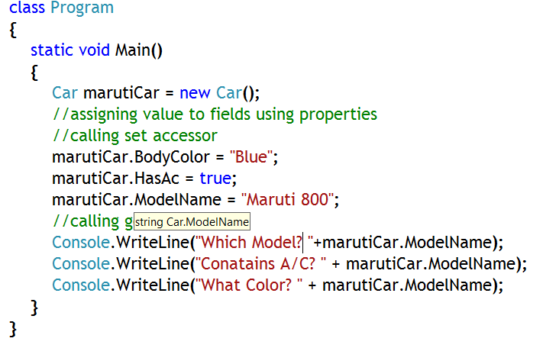
How to use Property?
Set value of private fields though property (actually calling set accessor)
Return value from private fields through property (actually get accessor)

Slide 21
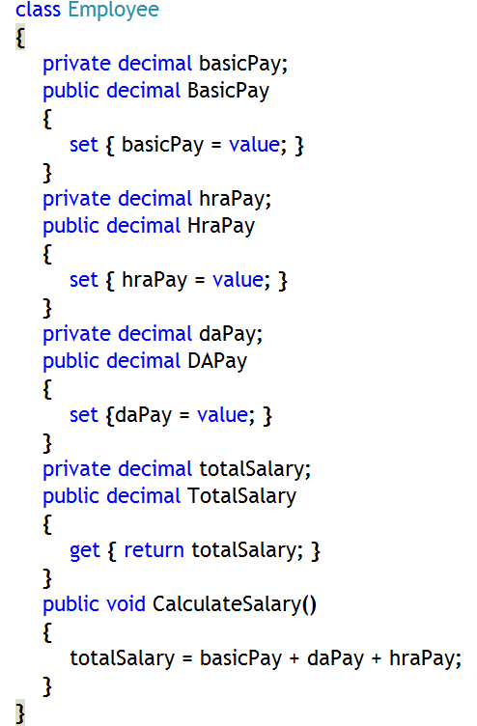
Property Types
Read/write properties
Have both get and set accessors
Sets value to and gets value from a field
Write-only properties – very limited use
Have set accessor only
Just sets the value to a field
Read-only properties
Have get accessor only
Just returns value of some field

Slide 22
Methods in C#
A method is a code block that contains a series of statements.
A program causes the statements to be executed by calling the method and specifying any required method arguments.
In C#, every executed instruction is performed in the context of a method.
The Main method is the entry point for every C# application and it is called by the common language runtime (CLR) when the program is started.

Slide 23
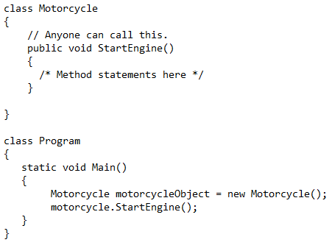
Examples of methods in C#
1. Methods are declared in a class or structure by specifying the access level such as public or private, the return value, the name of the method, and any method parameters.
2. These parts together are the signature of the method.
1. Calling a method on an object is like accessing a field.
2. After the object name, add a period, the name of the method, and parentheses.
3. Arguments are listed within the parentheses, and are separated by commas.

Slide 24
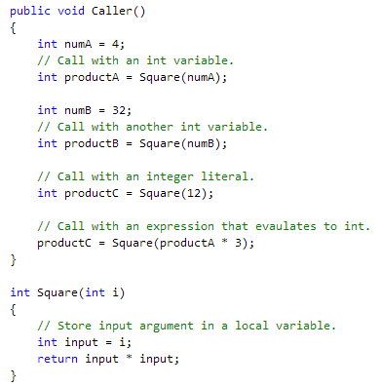
Method Parameters Vs. Arguments
The method definition specifies the names and types of any parameters that are required.
When calling code calls the method, it provides concrete values called arguments for each parameter.
The arguments must be compatible with the parameter type but the argument name (if any) used in the calling code does not have to be the same as the parameter named defined in the method.

Slide 25
Comparing Properties to Fields and Methods
Properties are “logical fields”
The get accessor can return a computed value
Similarities
Syntax for creation and use is the same
Differences
Properties are not values; they have no address
Properties cannot be used as ref or out parameters to methods
Similarities
Both contain code to be executed
Both can be used to hide implementation details
Both can be virtual, abstract, or override
Differences
Syntactic – properties do not use parentheses
Semantic – properties cannot be void or take arbitrary parameters

Slide 26
Type of Member in a Class
There are two types of member in a class:
Instance or non-static
Static
Notes:
Faculty Note:
Discussion about static members

Slide 27
Object/Instance Member
Object data describes information for individual objects
For example, each bank account has its own balance. If two accounts have the same balance, it is only a coincidence.
Instance data is accessed through the instance of the class
Withdraw( )
Withdraw( )
Deposit( )
Deposit( )
balance 12.56
balance 12.56
owner "Bert"
owner "Fred"

Slide 28
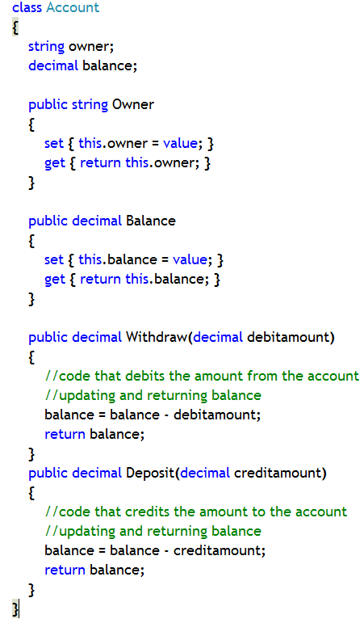
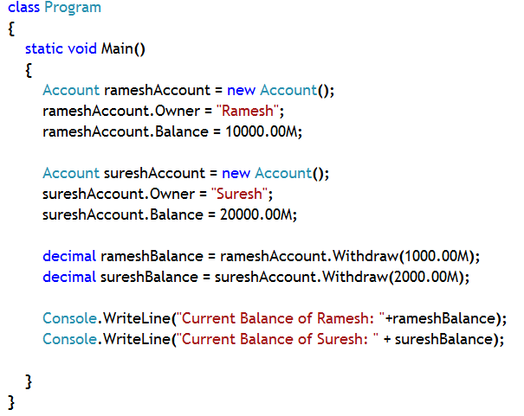

Example: Instance Member
Instance data, property and methods
Notes:
In this example:
Account is class which represents accounts of different persons
It has two fields, namely ‘owner’ and ‘balance’
Withdraw method debits some amount from your account and returns the updated current balance
Deposit method credits some amount to your account and returns the updated current balance
To objects of Account class has been created, one for Mr. Ramesh and another for Mr. Suresh
Some amount is there in their account as Balance
Some amount has been debited from each of their account and updated balance has been returned by Withdraw() method
Notice: Balance is different for different object (as well as Owner data)
Balance (and Owner) is instance data, contains different values for different instances

Slide 29
Declaring Readonly Variables and Constants
Constant Variable
Value of constant field is obtained at compile time
Value is stored in Assembly (in Type Metadata section).
No memory space allocation during runtime
Can be assigned only through field-initialization technique
compile time
Value of read-only field is obtained at run time
Value is not stored in assembly.
Memory space is allocated during run time
Can be assigned through constructor and field-initialization technique
run time
Read-only variable

Slide 30
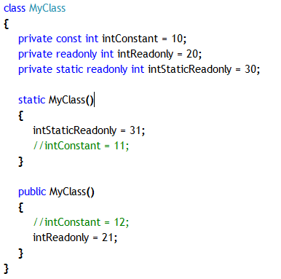
Initializing readonly and constant Fields
Readonly fields must be initialized
Explicitly at their declaration in a variable initializer and inside an instance constructor
Static read only variable can be assigned explicitly inside static constructor and at their declaration in a variable initalizer
Constant variable must be initialized
Explicitly at their declaration in a variable initializer
Can’t be explicitly initialized anywhere else
Not Possible
Not Possible

Slide 31
Using Namespaces
Scope
Resolving Name Clashes
Declaring Namespaces
Fully Qualified Names
Declaring using-namespace-directives
Declaring using-alias-directives
Guidelines for Naming Namespaces

Slide 32
Scope
The scope of a name is the region of program text in which you can refer to the name without qualification
public class Bank
{
public class Account
{
public void Deposit(decimal amount)
{
balance += amount;
}
private decimal balance;
}
public Account OpenAccount( ) { ... }
}

Slide 33
Resolving Name Clashes
Consider a large project that uses thousands of classes
What if two classes have the same name?
Do not add prefixes to all class names
// From Vendor A
public class Widget public class VendorAWidget
{ ... } { ... }
// From Vendor B
public class Widget public class VendorBWidget
{ ... } { ... }
û

Slide 34
Declaring Namespaces
namespace VendorA
{
public class Widget
{ ... }
}
namespace VendorB
{
public class Widget
{ ... }
}
namespace Microsoft
{
namespace Office
{
...
}
}
namespace Microsoft.Office
{
}
shorthand

Slide 35
Fully Qualified Names
A fully qualified class name includes its namespace
Unqualified class names can only be used in scope
namespace VendorA
{
public class Widget { ... }
...
}
class Application
{
static void Main( )
{
Widget w = new Widget( );
VendorA.Widget w = new VendorA.Widget( );
}
}
û
✓

Slide 36
Declaring using-namespace-directives
Effectively brings names back into scope
namespace VendorA.SuiteB
{
public class Widget { ... }
}
using VendorA.SuiteB;
class Application
{
static void Main( )
{
Widget w = new Widget( );
}
}

Slide 37
Declaring using-alias-directives
Creates an alias for a deeply nested namespace or type
namespace VendorA.SuiteB
{
public class Widget { ... }
}
using Widget = VendorA.SuiteB.Widget;
class Application
{
static void Main( )
{
Widget w = new Widget( );
}
}

Slide 38
Guidelines for Naming Namespaces
Use PascalCasing to separate logical components
Example: VendorA.SuiteB
Prefix namespace names with a company name or well-established brand
Example: Microsoft.Office
Use plural names when appropriate
Example: System.Collections
Avoid name clashes between namespaces and classes

Slide 39
Reference
For more information of OOP in C#, please visit the following link
http://www.msdn.microsoft.com/en-us/library
http://www.codeproject.com/
Notes:
Reference

